Slide 1
Improving the quality of your Delphi apps
Jeroen Pluimers
jeroen@pluimers.com
http://wiert.me
20151021
Nyborg, Denmark, 20151021

Slide 2
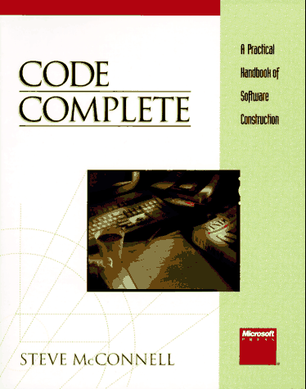
Welcome
Target of this course

Slide 3
Why Software Quality ?
Software is getting more and more important in all aspects of (human) life,
so failures have a big impact
All serious applications need modifications in due time, software life-cycles are not predictable
Quality reduces stress

Slide 4
How can you study
Software Quality ?
Books and articles have been written
  Increases your insight
  Stimulates good practices
  Enables you to argue about a decision
.. But that is not the emotional side
Building quality software depends on your passion for
  developing the right way and
  do it right the first time.

Slide 5
Software Quality: the human factor
<images>
  Group of people with communication
  Draw right and left handed
  Emotion versus Technique
Notes:
Code == poetry

Slide 6
RAD
‘Developing software faster
than you do now’
Steve McConnell

Slide 7
What is RAD and what does it have to do with Quality ?
RAD = Rapid Application Development
  Not just for the first phase
Doing it right the first time helps a lot
Low-effort, high-payoff techniques
Decisions like
  Make or buy
  Reuse
But:
  there is no silver bullet

Slide 8
Low-effort / High-payoff techniques
Aim to find
  low-effort techniques,
  principles and guidelines that have a high payoff
For instance:
  improving the quality of methods and comments can
  greatly ease the task of creating documentation
  (‘the asterisk problem’)
Notes:
The asterisk problem
Code Complete page 465

Slide 9
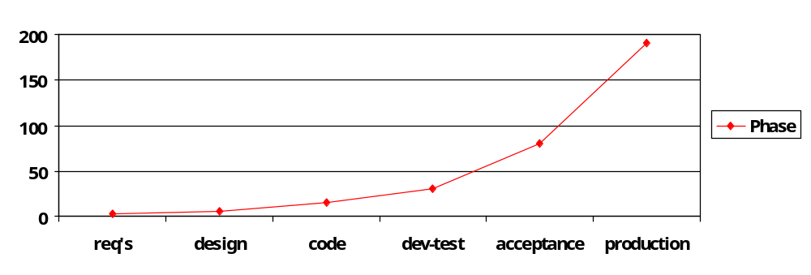
Upstream / downstream
Where did you introduce that bug ?
  Create processes that help you to find bugs as soon as possible
  Fix the bug when it’s found
  http://se.uwaterloo.ca/~dberry/COURSES/software.engr/lectures.pdf/inspect.pdf

Slide 10
Frameworks
Delphi is a fabulous general-purpose development tool.
But it gives the average developer too much freedom and too many choices that have to be made thoughtfully.
The consequences are:
  stress
  wrong decisions
  repetitive and boring work

Slide 11
Frameworks
Set of
    Components, objects, routines
    Guidelines
    Documentation templates
    Tools
  that lays on top of the development-tool with the aim to standardize and speed-up software construction.

Slide 12
What do you need for quality ?
You need a framework for rapidly developing quality Delphi applications
The design of your framework should be based on principles that are key to quality

Slide 13
Key Principles
…in a platform/language agnostic way

Slide 14
Break up your sourcecode !
Gains:
  Focus attention and energy
  Decrease complexity for the developer
  Increase ( conceptual ) overview
  Information Hiding
  Localise changes

Slide 15
Cohesion
“The act or condition of sticking together; a tendency to cohere; the force with which molecules cohere”
Strong cohesion is good;
weak cohesion is bad
It should be basically impossible to seperate the parts within a ‘unit’

Slide 16
Coupling
“A link connecting railway carriages etc.; a connection between two systems”
Loose coupling is good;
tight coupling is bad
A communication-path should be as less specific as possible ( no knowledge of internals of the other unit )

Slide 17
Interfaces
“A surface forming a common boundary between two regions; a point where interaction occurs between systems”
Interfaces should be defined and documented formally

Slide 18
Indirection
“Not going straight to the point”
Indirection is very good;
up to a certain point
Indirection gives you more control over communication in a centralized location

Slide 19
Indirection
Private Variable
read
write
Property
read
write
Client

Slide 20
Simplify
“Make simple; make easy or easier to do or understand”
Simplification is good
Make your application and especially the structure of the application as simple as possible
Low-tech is more maintainable than high-tech

Slide 21
Create Documentation
“The most important part of design that gets started when the application is almost finished and often is done by handwritten notes in a scrapbook”
Documentation should be done right the first time
Create guidelines and templates
for Word and source-code

Slide 22
Create Documentation
Source code is often the only accurate description of the software. So make sure it is readable and of the highest quality.

Slide 23
Use OOP wisely
Abstraction
Encapsulation
Inheritance
  Multiple Class Inheritance is not such a good idea
Polymorphism
  (Multiple) interface implementation is a good idea
When used properly, OOP can increase quality, but if not it will make things very bad

Slide 24
Delphi
some key principles in more detail…

Slide 25
Self-documenting code
The only part of the software that is guaranteed to be done is the code!
So create self-documenting code
  Variable and method names
  Proper layout

Slide 26
Comments
A comment can be
  Repeat of the code
  Explanation of the code
  Marker in the code
  Summary of the code
  Description of the code’s intent

Slide 27
Comments
Make writing comments as smooth as possible
  Layout
    No special formatting (VCL unit headers are a dork!)
    No endline // comments, except for declarations
  PDL-to-code (Program Design Language)
    Start with some comments on the ‘what’
    Then replace them with the ‘how’
  Comment as you go
  Avoid excessive commenting

Slide 28
Comments
Make every comment count
  Do not comment for silly purposes
  Document surprises and workarounds
  Avoid abbrvtns
‘Don’t document bad code -- rewrite it’
Kernighan and Plauger (1978)

Slide 29
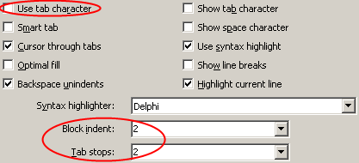
Constructing readable sourcecode
Sourcecode Layout
  Consistency is important
  Editor options:
  Quality layout matches
  the logical structure of the code

Slide 30
Constructing readable sourcecode
Sourcecode should be formatted for the human reader, not the computer
  Accurately represent the logical structure
  Consistently represent the logical structure
  Improve Readability
  Withstand modifications
Notes:
- X := 3+4 * 2+7; zou moeten zijn: x := ( 3+4 ) * ( 2+7 ) of x := 3 + ( 4*2 ) + 7
- Nog een slecht voorbeeld:
if y = 1 do
showmessage( ‘test’ );
showmessage(‘hallo’);
Hier had een begin…end statement gebruikt moeten worden, of de code moet anders geformatteerd worden.

Slide 31
Constructing readable sourcecode
Use whitespace
  Grouping
  Blank lines
  Make logical expressions readable
Alignment
  Groups of related assignments
  Data declarations
Indentation ( 2 - 4 spaces is best )
Use more parentheses
Notes:
- “Program Indentation and Comprehensibility” Miaria ea 1983
Subjects scored 20 to 30 percent higher on a test of comprehension when programs had 2-4 spaces indentation scheme than they did
when programs had no indentation at all.
Second lowest: six-space indentation, although people said it looker better readable.
Code Complete, p 409-410

Slide 32
Constructing readable sourcecode
Indentation styles
  http://courses.knox.edu/cs322/322PDFLectures/L16Coding.pdf
  Pure blocks are not an option in pascal
  Endline layout is horrible
  Emulated pure blocks
  Begin-end block boundaries
if (i > 10) then
statement1;
statement2;
end;
if (i > 1000) then begin
x := 21;
y := 36;
end
else z := 15;

Slide 33
Constructing readable sourcecode
Do not use lines longer than
the screen width
(80/100/… characters)
Layout comments with their corresponding code
Use paragraphs
  White space is important!

Slide 34
Use assertions
Document pre- and post-conditions using comments,
especially if they are not obvious
Check for pre- and post-conditions using the Assert keyword
    Assert(Count > 10,
    'not enough records');

Slide 35
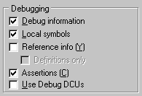
Use Assertions
procedure Assert
(
expr : Boolean
[; const msg: string]
);
Raises
  EAssertionFailed
Project Options | Compiler
Notes:
Tests whether a boolean expression is successful.
Unit
System
Category
miscellaneous routines
procedure Assert(expr : Boolean [; const msg: string]);
Description
Use Assert as a debugging tool to test that conditions assumed to be true are never violated. Assert provides an opportunity to intercept an unexpected condition and halt a program rather than allow execution to continue under unanticipated conditions.
Assert takes a boolean expression and an optional message string as parameters. If the boolean test fails, Assert raises an EAssertionFailed exception. If a message string was passed to Assert, the exception object is created with that string. Otherwise it is created with a default string indicating that the assertion failed. The message is displayed along with the complete path, filename, and the line number on which Assert failed.
The component library catches all exceptions. If, however, an EAssertionFailed exception occurs where no user code catches it, such as in a console application, then the RTL will issue runtime error 227 and halt the program.
Because assertions are not usually used at run-time in shipping versions of a product, compiler directives are provided to disable the generation of assertion code. They are as follows:
$ASSERTIONS ON/OFF (long form)
$C +/- (short form)
These are global switches that take effect for the whole source file that contains the switches, regardless of their position in the file. It is not possible to enable and disable assertions for something smaller than a source file. Assertions are off by default.

Slide 36
Exception handling
Try…Finally
Try…Except
Global Exception Handler
  in message loop of TApplication
TApplicationHandler

Slide 37
Implementation, Interface
Declarations in interface can be seen outside that unit
The interface section cannot contain statements (executable code)
Variables declared in the interface section are globals: don’t use them

Slide 38
Classes and access-modifiers
private
  available only in that class and that unit
protected
  private + available in subclasses
public
  available to anyone who USES that unit
published
  Runtime Type Information (RTTI) is generated. The Object Inspector needs RTTI to show properties and events.
strict private / strict protected
  Since Delphi 2005:
  Like private / protected, but excludes the unit

Slide 39
Interfaces and Classes
Classes implementing interfaces is another form of Polymorphism
  Some call it the “true polymorphism”…
Be aware of reference counting
http://wiert.wordpress.com/2009/08/20/delphi-tinterfaceddatamodule-revisted-inherited-in-your-dfm-files-when-your-datamodules-look-like-forms-in-the-designer/
Some notes
  The .NET framework relies heavily on Interfaces
  The VCL framework not, because of backward compatibility
  But you are free to do your own!

Slide 40
Properties
Learn to create properties, also in forms and datamodules
Use Set- and Get-methods where appropriate
Ctrl-Shift-C can be a great help
Using ModelMaker Code Explorer helps even more
  www.modelmakertools.com/code-explorer

Slide 41
Events
An event is a property of datatype ‘method-pointer’
    type
    TNotifyEvent = procedure (Sender: TObject) of object;
  It contains two pointers
    To an object instance
    To a method
You can assign events at runtime
    MyForm.Button1.Click := MyForm.Button3Click;
Events are a terrific way to decouple units
(two-way communication with a one-way USES clause)
Delphi unfortunately has a single-cast event handling system

Slide 42
Datamodules
Datamodules is not about data
  They are about “non-visual”
Use datamodules for all situations, where you want to
  easily use Delphi components,
  adapt properties in design-time,
  create events in design-time
  do not need user-interface

Slide 43
TActionList / TActionManager
Use TActionLists to separate application code from the User Interface
TActionLists allow you to bring events from the form to the datamodule
And they centralize some UI-properties
(is this good?)
They have some quirks, so make sure you try before you use them

Slide 44
TFrame and Visual Form Inheritance
Visual Form Inheritance and TFrames and are not always good for maintenance:
  you can (too) easily change ‘descendants’
It is better to create your own “SuperComponents”, for instance based on TFrame

Slide 45
Build your own components
“Component Templates” are good for
copy-paste, don’t use them as a replacement for components

Slide 46
Build your own components
Creating your own components can
  Dramatically speed up development
  Make your applications behave and feel much more consistent
  Reduce maintenance, because of one central code-location

Slide 47
Code generation
Makes maintenance more difficult most of the time, because of code-duplication
This can be made better when the generator
  supports round-trip engineering (two-way)
  generates classes in a hierarchy
    TBaseXxxx (generated each time)
    TXxx (generated once)

Slide 48
Good programming techniques
that work for any language or platform

Slide 49
Think
Study at SEL 1987 found that extensive computer use (edit, compile, link, test) is correlated with low productivity.
Of course our tools have changed a lot.
But still:
use your brain, not just your compiler !

Slide 50
Think
Write your code for the reader,
not for yourself.

Slide 51
Code defensively
Always assume that
you or somebody else
is going to make mistakes
  Keep the code simple
  Anticipate problems
  Use assertions liberally
  Document difficult code

Slide 52
Coding: methods

Slide 53
1. Design the method
Define
  Purpose
  Name
  How to test it
  Research re-use
Write PDL (Program Design Language)
Think about the data
Check the PDL
Iterate

Slide 54
2. Code the method
Code
  Construct the declaration
  (that’s the interface of the routine)
  Turn PDL into comments
  Fill in the code below each comment
  Check the code informally
  Clean up the leftovers
  Iterate

Slide 55
3. Check the method
Check
  Mentally check the code for errors
  Compile the code
  Use the debugger to step through the code
  Remove errors
  Iterate

Slide 56
Coding: Data

Slide 57
Creating data
Use
  User defined types
  Classes
  TClientDatasets

Slide 58
Creating data
Use a template to declare variables
Document the meaning of variables
Use naming conventions
  F* for private variables
Remove unused declarations
var
Index: Integer; // meaning of Index: better rename Index

Slide 59
Creating data
Initialize each variable close to where it is used (not at the top of the method)
Keep related actions together
Principle of proximity

Slide 60
Creating data
Use the initialization-section to initialize variables with a global scope and lifetime.

Slide 61
Data names
A Variable = Its Name
Use good names
  Readable
  Memorable
  Appropriate
A variable should fully and accurately describe
the entity that the variable represents.

Slide 62
Data names
Use obvious words
  ‘LinesPerPage’ is much better than ‘LPP’
Express the what, not the how
  ‘PrinterIsReady’ instead of ‘BitFlag’

Slide 63
Data names
Length
  Optimum: 10-16 characters
  Almost as good: 8-20 characters
Use i, j or x only in a limited, local scope
But as soon as loops are nested,
use longer names

Slide 64
Data names
Watch out with ‘temporary’ variables
  Temporary may indicate that you aren’t sure of their real purposes
Same with names like:
  Util/Utils
  Tool/Tools
  Misc
  Other

Slide 65
Data names
Typical boolean names
  Done
  Error
  Found
  Success
Boolean variables names should
  imply True / False (not: ‘Status’) and
  they should be positive (not: ‘NotFound’).

Slide 66
Data names
Enumerated Types and Sets
  Use prefixes (or suffixes) to group values
Often better than booleans
especially when used as parameters
    procedure Paint(Value: string; Background: Boolean = True)
    Paint('Programming is fun!', False);
  Versus
    type
    TPaintBehaviour = (bhForegroundOnly, bhBackgroundAndForeground)
    procedure Paint(Value: string;
    Behaviour: TPaintBehaviour = bhBackgroundAndForeground)
    Paint('Programming is fun!', bhForegroundOnly);

Slide 67
Data names
Constants
  Variables Don't; Constants Aren't
Don’t use capitals and underscores
Name them like data
http://en.wikipedia.org/wiki/Constant_(programming)

Slide 68
Data names: abbreviations
In general:
  Don’t
If you have to:
  Do not remove just one characte from a word
  Abbreviate consistently
  Create names that you can pronounce
  Avoid combinations that result in mispronounciation
  Use a thesaurus
  Document short names with translation tables

Slide 69
Data names: abbreviations
Avoid
  misleading names or abbreviations
  names with similar meanings
  variables with different meanings but similar names
  Names that sound similar or can be pronounced obscene
    Uranus
  Numerals in names
    ForWeddingsAndAFuneral

Slide 70
Data names: abbreviations
Avoid
  Mispelled words in names
  Words that are commonly mispelled
  Names of standard routines and variables
  Names that are totally unrelated to what they represent
  Names that contain hard-to-read characters
  (‘confusion’ vs. ‘c0nfusion’)

Slide 71
Naming Conventions
Global decisions
Transfer knowledge
Reduce name proliferation
http://stackoverflow.com/questions/262892/what-delphi-coding-standards-documents-do-you-follow
  Embarcadero/CodeGear/Borland standard
  JCL/JVCL standard
  Econos standard

Slide 72
Naming Conventions
Identify type definitions (‘T’, ‘E’)
Identify fields (‘F’)
Format names to enhance readability
(not “GYMNASTICSPOINTTOTAL”)
Optionally:
  Identify global and module variables
  (‘g_’ and ‘m_’)
Better:
  Do not use globals at all:
  Use class variables in stead.

Slide 73
Naming Conventions
Some use Hungarian
  Base types
  (wn [Window], ch [character]…)
  Prefixes
  (a [array], c [count]…)
  Standard Qualifiers
  (Min, First, Last…)

Slide 74
Variables: general issues
Scope
  Minimize scope
  Keep references to a variable together
Binding
  Use late binding for the contents of variables
    Code-time A := 47;
    Compile-time A := NumberOfBars;
    Run-time A := GetNumOfBarsFromIniFile ();

Slide 75
Variables: general issues
Use
  Use each variable for exactly one purpose
    One purpose only
    Avoid hidden meanings ( 1..100, -1 )
    Use all declared variables

Slide 76
Variables: general issues
Problems with globals
  Inadvertent changes to global data
  Aliasing problems with global data
  Thread conflicts
  Code reuse hindered by global data
  Modularity and intellectual manageability damaged by global data

Slide 77
Variables: general issues
Instead of globals
  Create access routines
  Create a global variable that contains an object with properties
  ( Application : TApplication in Forms.pas )
  Use class variables

Slide 78
Fundamental Data Types
Avoid ‘magic numbers’ and ‘magic strings’, use constants instead
The use of 0 (zero) and 1 (one) is allowed
Make type-conversions obvious
  Use a type-cast or
  Use a conversion
Avoid mixed-type comparisons
and floating point comparisons
  if (Pi = 3) then // bad for 2 reasons
Heed your compiler’s warnings
  The compiler is almost always right

Slide 79
Coding: Control statements

Slide 80
Using conditionals
if ( x ) then
begin
//
end
else
begin
//
end;

Slide 81
Using conditionals
Let the nominal path through the code not be obscured by the exceptions
Put the normal case after the if

Slide 82
Using conditionals
Follow the if-clause with a meaningful statement
Use >= etc. correctly: think through the endpoints
    if not (a >= 10)
    if (a < 10)
Consider the else clause and
maybe even create one to document that the else clause was considered:
    if (FailureCondition) then
    HandleFailure()
    else
    ; // no need to handle success
Check for the flip-flop error
Notes:
Flip-flop error: het stuk code for if staat bij else en vice versa

Slide 83
Controlling loops
Select the right kind of loop
  FOR…NEXT
  FOR…IN
  WHILE…DO test at begin of loop
  REPEAT…UNTIL test at end of loop;
  runs at least once

Slide 84
Controlling loops
Initialize variables directly before the loop
Do variable housekeeping for the loop at the beginning or end of the loop
Make each loop perform only one function
Assure yourself that the loop ends
Make termination conditions obvious
Don’t monkey with the loop index (i)
The loop index is undefined after exiting the loop!

Slide 85
Controlling loops
Avoid
  CONTINUE
  BREAK
  EXIT
Use if-statements instead

Slide 86
Controlling loops
Make your loops short enough to view all code at once
Limit nesting to three levels
Make long loops especially clear

Slide 87
Unusual Control structures
Goto
Recursion
  Make sure it stops
  (use safety counter during debug/test)
  Limit to one routine (not: A > B > C)
  Keep an eye on the stack

Slide 88
General Control structures
Booleans
  Make complicated tests simple:
  break them in parts or use functions
  Form boolean expressions positively
    if not Failure
    if not NoSuccess
    if Success
  Use parentheses

Slide 89
General Control structures
Compound statements
(begin/end blocks)
  Use them instead of single statements
  Do not nest too deeply
    Retest some of the conditions
    Use if…then…else
    Use a CASE statement
    Construct new methods
    Redesign deeply nested code

Slide 90
Modularizing data layers
Cohesion, coupling, interfaces, indirection, simplify
All in one example

Slide 91
Delphi – Modularization
Average Delphi app unit structure
Main Form
Customer
Form
Customer
Data
Module
Order
Form
Order
Data
Module
Database
Data
Module

Slide 92
Delphi – Modularization
Good Delphi app unit structure
Main Form
Customer
Form
Customer
Data
Module
Order
Form
Order
Data
Module
Database
Data
Module

Slide 93
How come good is better than bad?
Look for modularization in real life…
  Houses - rooms
  Cities - suburbs/blocks
  People - digestion system
  Parliament - parties
Sometimes modularization works
Sometimes it doesn’t ☺

Slide 94
Modules are everywhere…
So why does it work?
  Internal Cohesion HIGH
  External Coupling LOW
    If also ‘uniform’: great!
    If also ‘directional’: even better!
Notes:
Low external coupling makes your modules less dependent on each other.
It will become easier to split a module or move features form one module to another
Directional coupling gives a clear indication about what depends on what.

Slide 95
Modularization – database apps
Let’s apply this knowledge
to our database apps
Especially: where to put the DataSource…
Where is your DataSource?

Slide 96
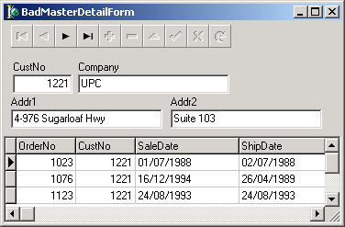
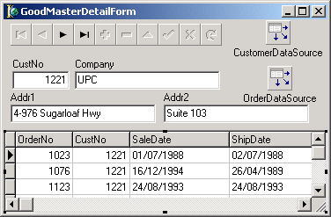


Modularization – DataSource
Bad 3 Internal Links
6 External Links
Good 6+2 Internal 2 External
Notes:
Except for coneptual reasons, this is also handy for practial reasons
Sometimes the Delphi IDE ‘forgets’ external links and erases them.
If you have few external links, they are much easier to retore.

Slide 97
Modularization – the datasource
DataSource has two goals
    Binding GUI controls
    Providing Master-Detail relations
  GUI binding:
  put DataSource on Form
  MD-relations:
  put DataSource on DataModule

Slide 98
Modularization – gain
Flexibility
  Change of GUI
  Change of Data Access
  Re-use of modules across projects

Slide 99
Know your VCL
Delphi 5 Object Hierarchy.pdf
Delphi 7 - VCLHierarchyPoster.pdf

Slide 100
Know new features
for … in
Generics
Anonymous methods

Slide 101
for … in
for Win32, it was introduced
in D2005
  On lots of built-in data types
    Arrays
    Strings
  On many data types
    Lists, Collections, Trees,
    Components, Actions, Menus, Fields,
    many, many more …

Slide 102
Data types supporting for … in
  These data types
    provide either of these:
      function GetEnumerator: T…Enumerator;
      function GetEnumerator: IEnumerator;
    and the result provides these functions:
      constructor Create(
      const AObject: T…Object);
      function GetCurrent: T…;
      function MoveNext: Boolean;
      property Current: T… read GetCurrent;
  The compiler then recognizes it supports for … in

Slide 103
Business logic versus glue…
procedure TXokumDataModule.GetMinMaxAbonneeNummerOldStyle(
var MinAbonneenummer: Integer;
var MaxAbonneeNummer: Integer);
var
WasActive: Boolean;
begin
MinAbonneenummer := High(Integer);
MaxAbonneeNummer := Low(Integer);
WasActive := XokumClientDataSet.Active;
XokumClientDataSet.Open;
XokumClientDataSet.First;
while not XokumClientDataSet.Eof do
begin
if XokumClientDataSetabonneenummer.Value > MaxAbonneeNummer then
MaxAbonneeNummer := XokumClientDataSetabonneenummer.Value;
if XokumClientDataSetabonneenummer.Value < MinAbonneeNummer then
MinAbonneeNummer := XokumClientDataSetabonneenummer.Value;
XokumClientDataSet.Next;
end;
if not WasActive then
XokumClientDataSet.Close;
end;

Slide 104
Wouldn’t it be nice to…
procedure TXokumDataModule.GetMinMaxAbonneeNummer(
var MinAbonneenummer: Integer;
var MaxAbonneeNummer: Integer);
var
Index: TDataSetEnumerationRecord;
begin
MinAbonneenummer := High(Integer);
MaxAbonneeNummer := Low(Integer);
for Index in XokumClientDataSet do
begin
if XokumClientDataSetabonneenummer.Value > MaxAbonneeNummer then
MaxAbonneeNummer := XokumClientDataSetabonneenummer.Value;
if XokumClientDataSetabonneenummer.Value < MinAbonneeNummer then
MinAbonneeNummer := XokumClientDataSetabonneenummer.Value;
end;
end;

Slide 105
Helpers
Introduced in Delphi to support .NET
  The .NET class hierarchy differs from Win32 VCL
  In the .NET framework, VCL methods and properties were different or missing
Helpers can make extensions at function level
  Yes: methods and properties
  No: instance data
They also work in Delphi for Win32:
  Class helpers since Delphi 2005
  Record helpers since Delphi 2006

Slide 106
Helpers
Helpers (class or record):
  function as long as the helper is visible to the user
So:
  Helper in the same unit,
  or helper in a unit in the uses list

Slide 107
Generics
Great document:
ftp://ftp-developpez.com/sjrd/tutoriels/delphi-generics/delphi-generics.pdf
Basically:
    type
    TList<T> = class(…)
    var
    MyIntegerList = TList<Integer>;
    MyStringList = TList<string>;
Lots of examples:
  see demo later on

Slide 108
Anonymous methods
Inline block of code
Like a regular method
With parameters
Optional function result
But without a name
http://stackoverflow.com/questions/256146/can-someone-explain-anonymous-methods-to-me
http://blogs.embarcadero.com/abauer/2008/09/25/38870

Slide 109
Anonymous example
class procedure TScreenSupport.ExecuteWithWaitCursor(const Proc: TProc);
var
OldCursor: TCursor;
begin
OldCursor := Screen.Cursor;
try
Screen.Cursor := crHourGlass;
Proc();
finally
Screen.Cursor := OldCursor;
end;
end;
procedure TMyForm.Button1Click(Sender: TObject);
begin
TScreenSupport.ExecuteWithWaitCursor(
procedure
begin
TExcelSupport.Export(OverzichtEnsembleStringGrid);
end
);
end;

Slide 110
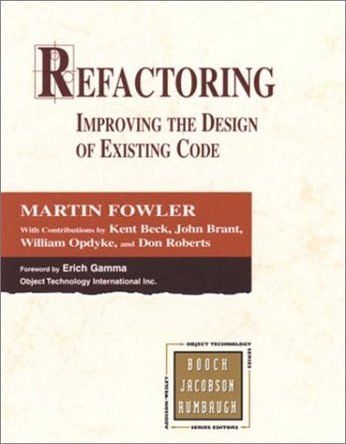
Code Refactoring

Slide 111
Testing
http://stackoverflow.com/questions/540617/best-way-to-test-a-delphi-application

Slide 112
Testing
Makes you find bugs faster
Helps “Fix the bug when it’s found”
Makes your total process cheaper
  Prepare to move some budget from “maintenance” to “development” cycle

Slide 113
Source testing
By humans only:
  Pair programming
  (immediate feedback)
  Peer review
  (feedback at a later time,
  for instance right before checkin)

Slide 114
Continuous integration
Build all your targets
  By hand once every while
  On each checkin, automagically
Helps find the “colleague A modifies X, but it now breaks at colleague B in application Y” sooner
Tools:
  Makefiles
  FinalBuilder
  CruiseControl

Slide 115
Unit testing
Comes from eXtreme Programming
and Agile Programming
Tests methods of classes
Built-in Delphi since Delphi 2005

Slide 116
UI testing
Use TestComplete from AutomatedQA
Good, not cheap (USD 999-1999)

Slide 117
General guidelines
Develop more, smaller routines
Reduce the number of globals
Improve your programming style
Manage changes
Review code changes
Retest

Slide 118
Constructing new methods
Reduce complexity
  by shortening
  by reducing nesting
Share code

Slide 119
Code Tuning Issues
Delivering on-time, on-budget
Providing a clean user-interface
Avoiding downtime
Constructing maintainable code
…may be more important to the user than
raw speed

Slide 120
Old Wives’ Tales
Reducing the lines of code improves the size or speed of the executable
  false
Certain operations are probably faster or smaller than others
  false
You should optimize as you go
  false
“You can get 80 percent of the result
with 20 percent of the effort”
The Pareto Principle

Slide 121
Strategies
Use a profiler
  http://stackoverflow.com/questions/368938/delphi-profiling-tools
  AQTime
  ProDelphi
  SamplingProfiler
Use the compiler optimizations
Use iteration

Slide 122
Where’s the fat ?
Database / Network traffic
Other Input/output operations
User interaction
Speed in decreasing order
  Network
  USB
  Hard drive
  Memory
All programming is an exercise in caching
Terje Mathisen

Slide 123
Techniques
Use a good modular design
Measure the system, if performance is poor
Determine the reasons for slow speed
Tune the bottleneck, if there is one
Iterate

Slide 124
Wrap-it-up

Slide 125
Share information
Make the targets visible to everyone on the team
Store documentation in one central place
Always (!) document errors that you found and the resolution to solve it
Log bugs in one central place

Slide 126
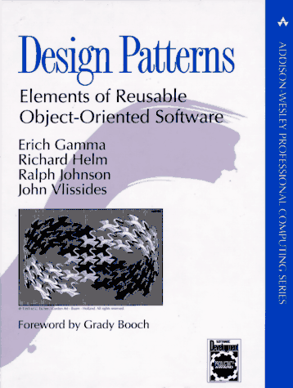
Short Overview of Design Patterns
Design Patterns is about
reusing approaches to problem-solving
A Design Pattern consists of
  The pattern name
  The problem
  The solution
  The consequences

Slide 127
Ten essentials for building good software
A product specification
A detailed user interface prototype
A realistic schedule
Explicit priorities
Active risk management
A quality assurance plan
Detailed activity lists
Software configuration management
Software architecture
An integration plan
from Steve McConnell

Slide 128
12 Classic Mistakes
Undermined motivation
Uncontrolled problem employees
Noisy, crowded offices
Abandoning planning under pressure
Shortchanging upstream activities
Shortchanging quality assurance
Lack of feature-creep control
Silver-bullet syndrome
Wasting time in the ‘fuzzy front end’
Insufficient user input
Overly aggressive schedules
Adding developers to a late project
from Steve McConnell

Slide 129
Sample projects
Demo time…
The good, the bad and the ugly

Slide 130
Tests
Belbin (xls) – the human factor
Joel – the team factor

Slide 131
Discussion time

Slide 132
Q & A
Jeroen Pluimers
jeroen@pluimers.com
If you have questions after the workshop, please mail me
my blog: http://wiert.me

